Slide 1
Female Employees and their challenges

Slide 2

Hello!
I am
Ankon Sarker Linkon(19-40895-2)
Welcome to my presentation!

Slide 3
Introduction
The number of female employees is increasing day by day. There are innumerable challenge and problems faced by them both at home and workplace. However, it is true that working women have to face problems by virtue of their sex. To face these challenges tactfully and overcome them successfully, women need to be self-confident and aware of women rights.

Slide 4
Problems faced by female
Gender pay gap.
Pregnancy discrimination.
Children and career.
Career opportunities.
Harassment.

Slide 5

Data analysis
This survey was performed by preparing some question based on “Female employees and their challenges”. After collecting 30 student's opinions we got the result that says…..

Slide 6
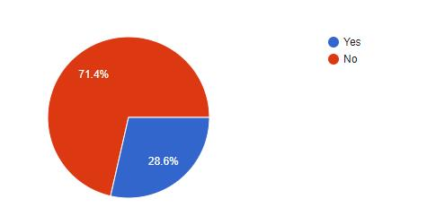
Harassed Rate in workplace

Slide 7
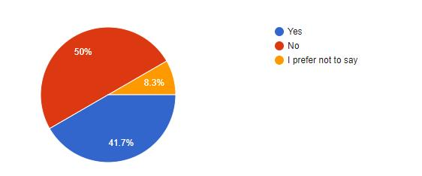
Reported rate of harassed female

Slide 8
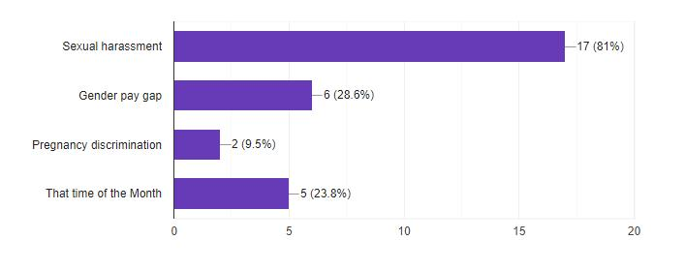
The rate of female employee's problems

Slide 9
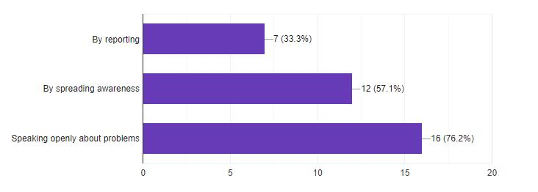
Preferred solution for prevent female employee's problems

Slide 10
Conclusion
What we find from the analysis report…

Slide 11

Thanks!
Any questions?

